Slide 1
Frame Relay

Slide 2
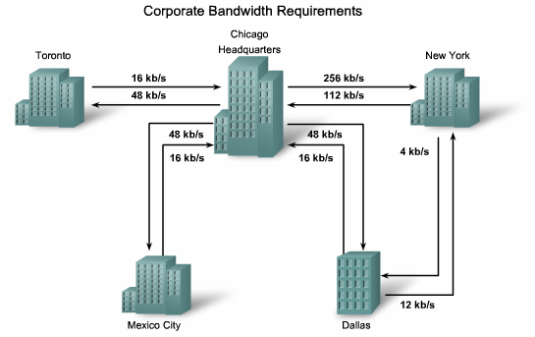
The Need for Frame Relay

Slide 3
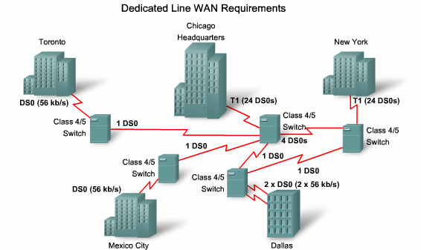
The Need for Frame Relay

Slide 4
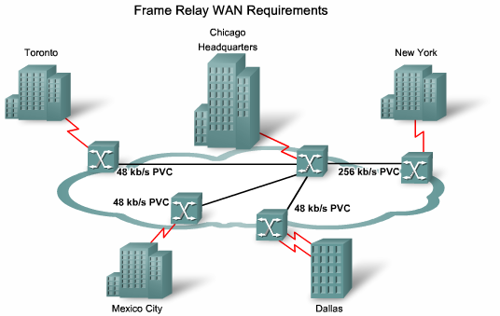
The Need for Frame Relay

Slide 5
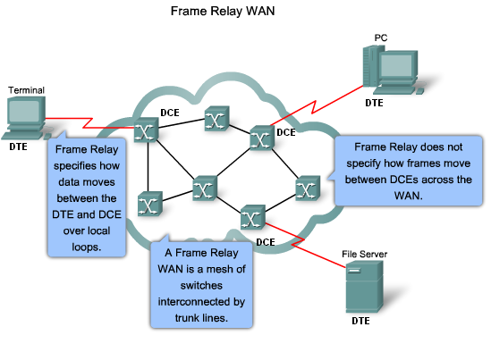
The Need for Frame Relay

Slide 6
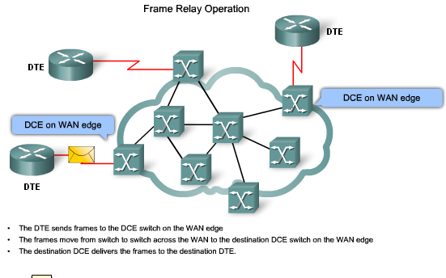
Frame Relay operation

Slide 7
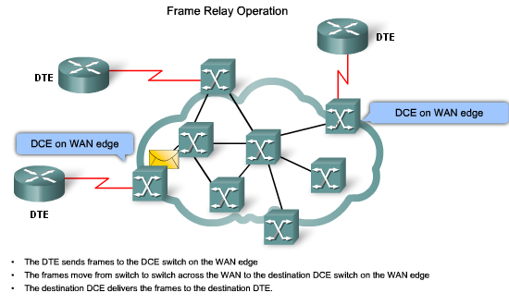
Frame Relay operation

Slide 8
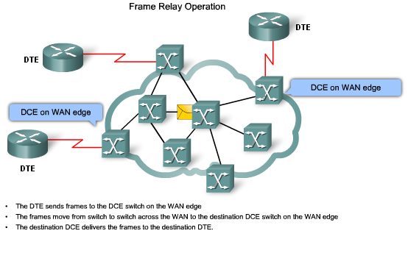
Frame Relay operation

Slide 9
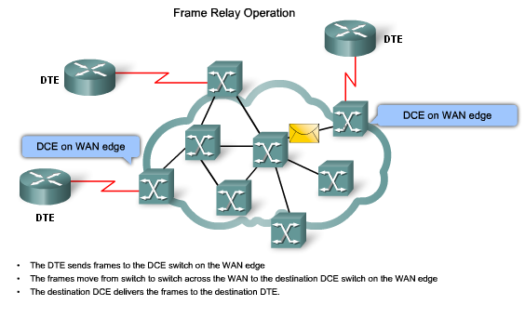
Frame Relay operation

Slide 10
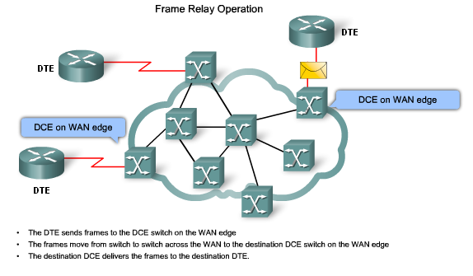
Frame Relay operation

Slide 11
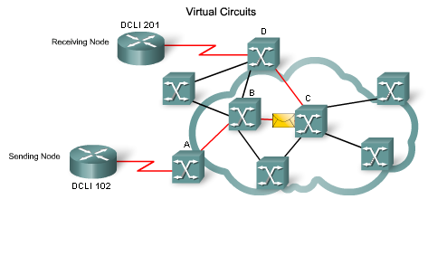
Virtual circuit

Slide 12
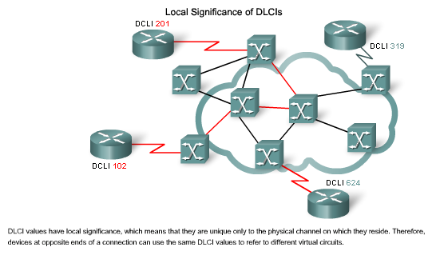
Virtual circuit

Slide 13
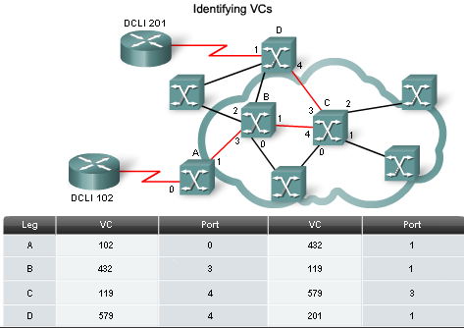
Virtual circuit

Slide 14
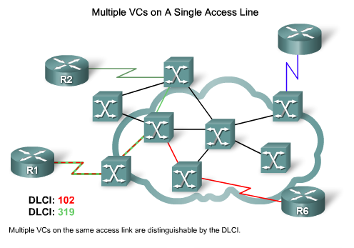
Virtual circuit

Slide 15
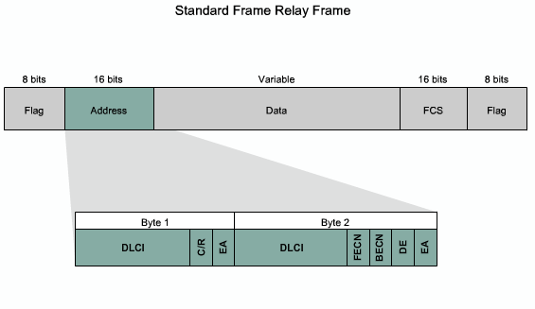
Frame relay header

Slide 16
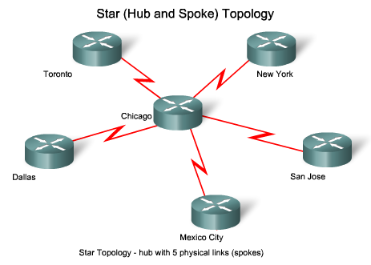
Frame relay topologies

Slide 17
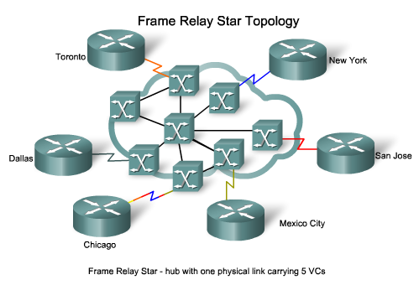
Frame relay topologies

Slide 18
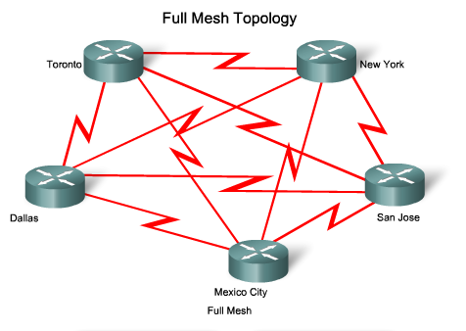
Frame relay topologies

Slide 19
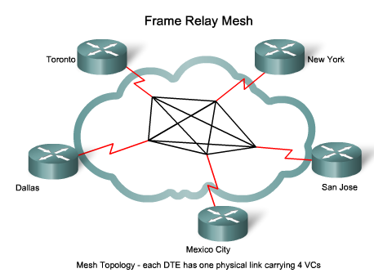
Frame relay topologies

Slide 20
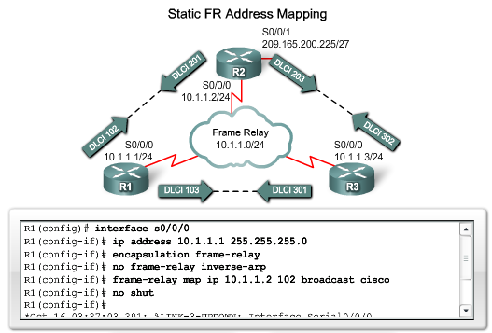
Frame relay map

Slide 21
LMI (Local Management Interface)
Signaling protocol between the router and the FR switch.
Used for management purpose.
It is used so as a router can get its local DLCI & their status from the FR switch.
VC status from LMI:
1- Active=2 sides are active.
2- Inactive = remote end failed but my side is active
3- Deleted = DLCI doesn’t exist

Slide 22
LMI (Local Management Interface)
LMI types:
1- ITU-T ---- Q.933a ------ Annex-A.
2- ANSI ----- Annex-D.
3- Cisco LMI.
The router will work with the LMI type supported by the FR switch.
LMI type is local between router and switch

Slide 23
Address Resolution (MAP)
1- Manual Resolution (static).
  Mapping between the DCLI no. and the next hop ip address using configuration.
2- Dynamic Resolution. (Inverse ARP)
  Used to know the unknown ip for a known DLCI (from LMI ).
  Works by default .

Slide 24
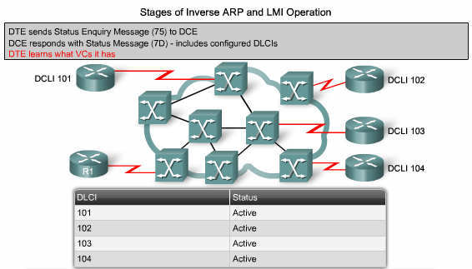
LMI operation

Slide 25
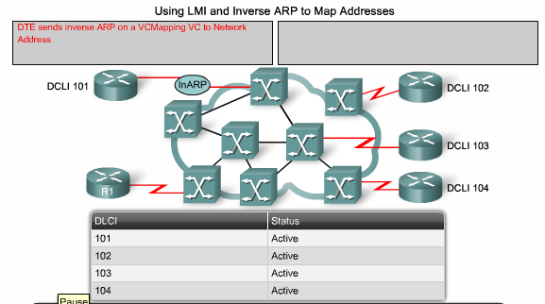
Inverse ARP

Slide 26
Frame Relay encapsulation types
CISCO → cisco propriatory
IETF → open standard
LMI is operating between the router & FR switch
Encapsulation is operating between source & destination router

Slide 27
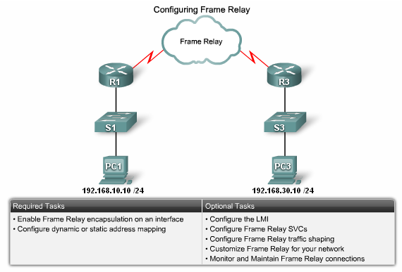
Frame relay configuration

Slide 28
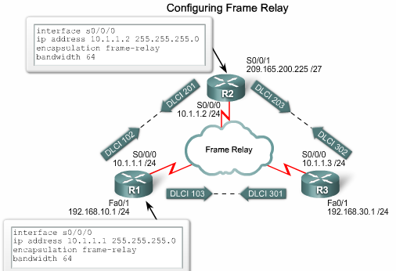
Frame relay configuration

Slide 29
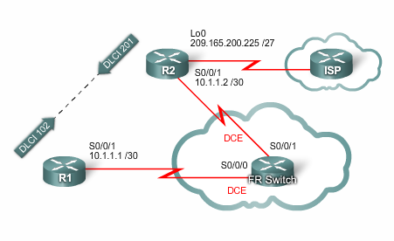
Frame relay configuration example

Slide 30
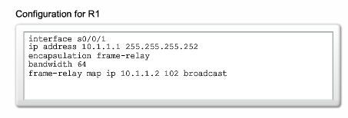
Frame relay configuration example

Slide 31
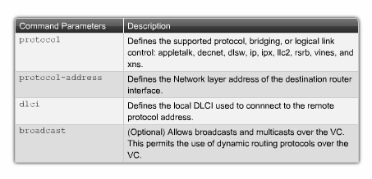
Frame relay configuration example

Slide 32
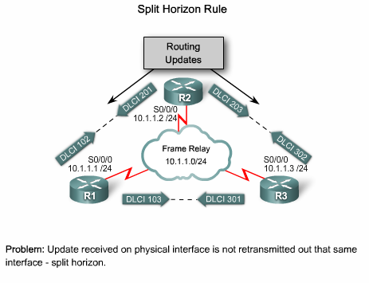
Frame relay issues

Slide 33
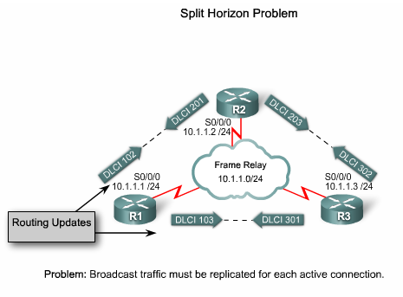
Frame relay issues

Slide 34
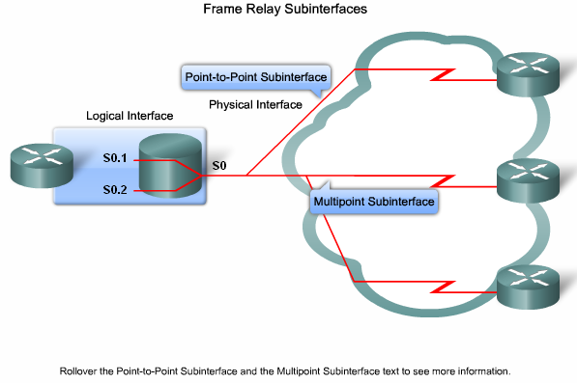
Frame relay sub-interfaces

Slide 35
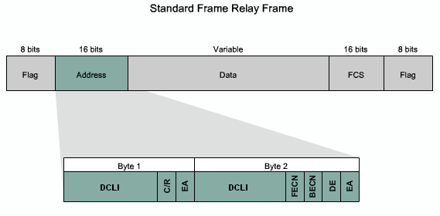
Frame relay congestion management

Slide 36
Frame relay congestion management
Backward Explicit Congestion Notification (BECN)
Forward Explicit Congestion Notification (FECN)

Slide 37
FR Congestion management
If the switch sensed very high rate , then it will set FECN to 1.
When the destination receives a frame with FECN =1, it will send a frame back to the source with BECN=1 asking the source to slow down.
#show frame-relay PVC

Slide 38
Subinterface configuration
(config)# int s0/0
(config-if)# encapsulation frame-relay [cisco / ietf]
(config-if)#no ip address
(config-if)#no shutdown
(config)# int s0/0.1 point-to-point
(config-subif)# frame-relay interface dlci <dlci no.>

